Slide 1
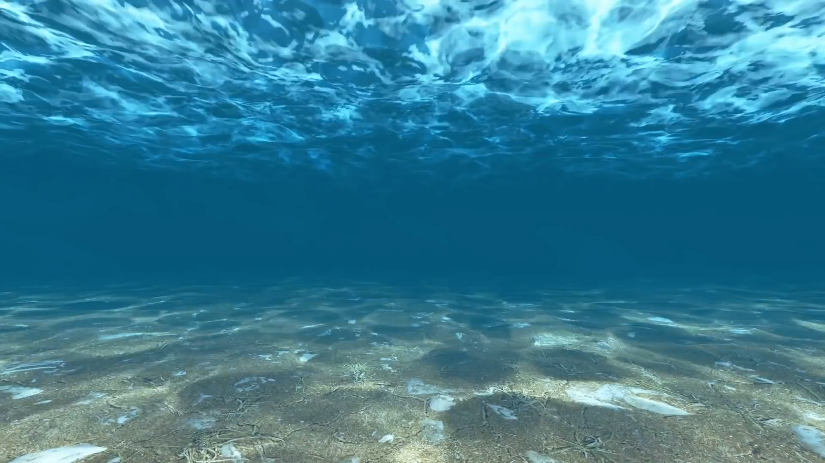



Underwater image quality enhancement by using convolutional neural network deep learning-based Algorithm
Yap jia jun
BS20110220
Prof madya dr Abdullah bade

Slide 2
01
Introduction
OVERVIEW • PROBLEM BACKGROUND • PROBLEM STATEMENT • OBJECTIVES • SCOPE • JUSTIFICATION

Slide 3
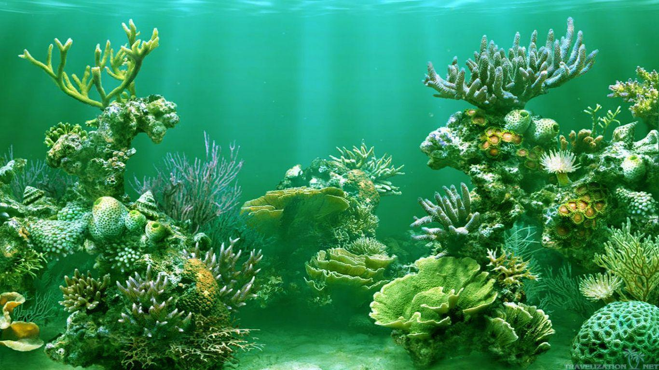
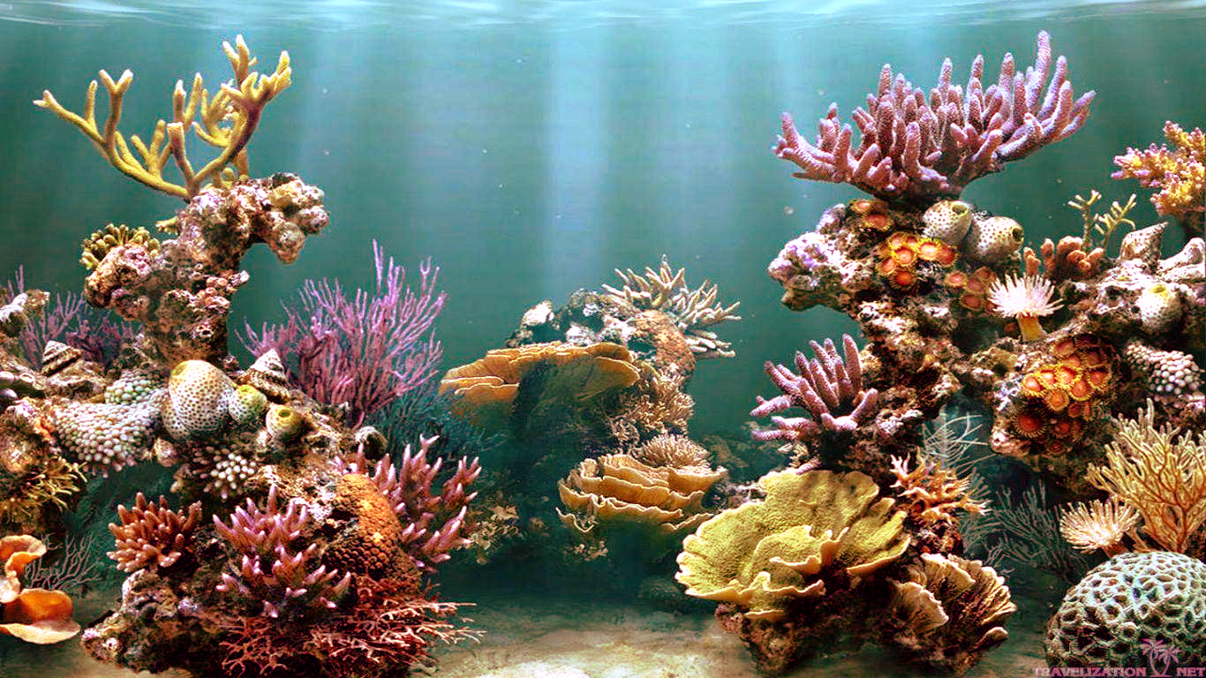
OVERVIEW
Underwater image quality enhancement
Techniques of digital image processing
Improve visual quality
Improve the reliability of information

Slide 4
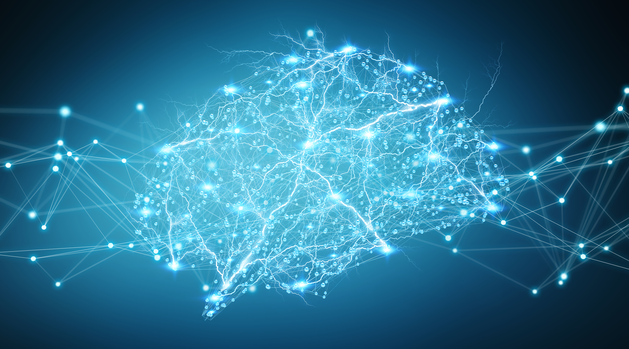
OVERVIEW
Deep learning
Subfield of machine learning
Train & learn from data
Consist of multiple interconnected artificial neural network
Used in object detection & classification

Slide 5
Problem background
Degradation of Underwater Image
Attenuation of Light
Reflection & refraction
Forward & backward scatter
Result in reducing light intensity, haze-like effect
Absorption of Light
Colour light being absorbed
Depends on wavelength
Result in a bluish and greenish tone

Slide 6
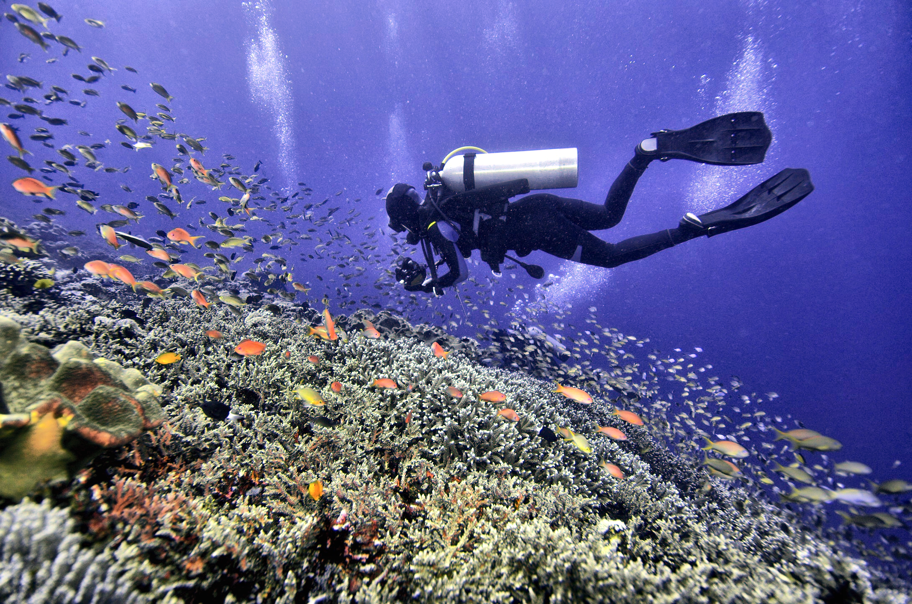
Example

Slide 7
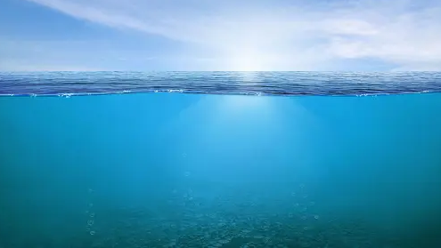

Slide 8

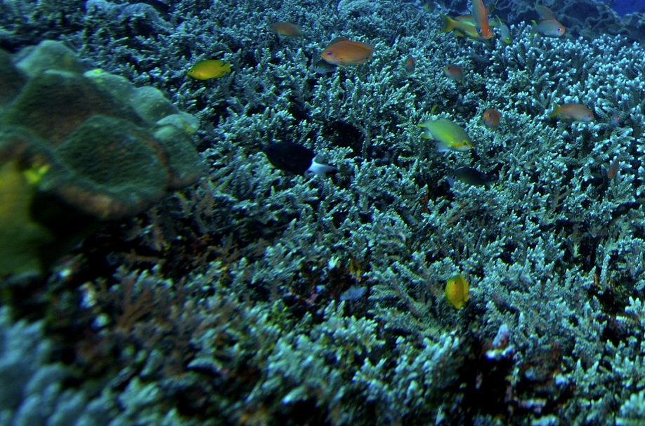
Natural Illumination (Sunlight)
Reflected
Refracted
Refracted
Direct Light
Adsorption
Backward Scatter Light
Scattering
Forward Scatter Light
Scattering
Original Scene
Scattering
Captured Scene

Slide 9
Problem background
Single-purpose method
Single image processing
Traditional Underwater
Image Enhancement
Manually extracting features
Image-specific enhancement parameters
Heuristic algorithms

Slide 10
Problem Statement
Unique Underwater Environment
Traditional Method
Distinct optical condition
Complex properties and features
Insufficient data
Time-consuming
Sequential image processing
Carried out manually
Lack of adaptability

Slide 11
Project objectives
To implement underwater image formation model to remove haze-like effect in the underwater images.
1
To train white balance model and combine with underwater image formation model in order to increase sharpness, contrast and colour balance in the degraded underwater colour images.
2

Slide 12
Project Scope
Underwater Static Image
Deep Learning Algorithm - CNN
Not include real-time processing
Focus On
Haze Removal
& Colour Restoration
Online Dataset &
Real-World Underwater Images

Slide 13
Justification
Complex Underwater Conditions
Automatic Feature Extraction
Data-Driven Approach
End-to-End Learning
Accurate analysis & research
Deeper understanding & preservation

Slide 14
02
Literature Review
UNDERWATER IMAGING MODEL • DEEP LEARNING-BASED UNDERWATER IMAGE ENHANCEMENT

Slide 15
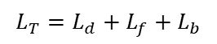
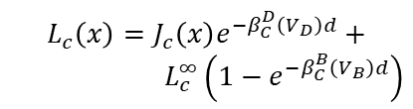
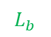
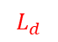
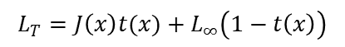
UNDERWATER IMAGING MODEL
Jaffe-McGlamery, 1980
Narasimhan-Nayar, 2002
Revised Formation, 2018
$$L_{b}$$
$$L_{c}\left(x\right)=J_{c}\left(x\right)e^{−β_{C}^{D}\left(V_{D}\right)d}+$$
$L_{c}^{∞}\left(1−e^{−β_{C}^{B}\left(V_{B}\right)d}\right)$
$$L_{T}=L_{d}+L_{f}+L_{b}$$
$$L_{T}=J\left(x\right)t(x)+L_{∞}\left(1−t\left(x\right)\right)$$
$$L_{d}$$
Most used model
Take into account all the pathways
Ideal condition
More practical
Omitted forward scatter light
Include attenuation coefficient and background light
Neglecting attenuation coefficient of different colour channels
Consider of three colour channels, RGB
Different attenuation coefficient for direct and backscatter light
Conform to complex underwater scene
Better in restore colour image

Slide 16
Deep learning-based underwater
image enhancement
Convolutional Neural Network
(CNN)
Haze Removal
Deep Learning
Generative Adversarial Network
(GAN)
Colour Restoration

Slide 17
Haze removal
Authors | Year | DLN | Description | Limitations
Cai et al. | 2016 | CNN | DehazeNet Single image Estimate transmission map | Assumed atmospheric light and attenuation coefficient as a global constant Using Narasimhan-Nayar Model
Wang et al. | 2017 | CNN | UIE-Net Estimate absorption coefficient Estimate transmission map | Assumed atmospheric light and as a global constant Using Narasimhan-Nayar Model Not fully-CNN implementation
Perez et al. | 2017 | CNN | Learn transformation Trained with different interventions | Without consider underwater imaging model The result is slightly worst than others existing method

Slide 18
Haze removal
Authors | Year | DLN | Description | Limitations
Pan et al. | 2018 | CNN | DehazeNet Estimate transmission map Refine with adaptive bilateral filter | Not fully-CNN implementation Using Narasimhan-Nayar Model
Yang & Sun | 2018 | CNN | Proximal DehazeNet Estimate dark channel Estimate transmission map | Not specific for underwater environment Using Narasimhan-Nayar Model
Li et al. | 2019 | GAN | Fused GAN Colour cast, low contrast Haze-like effects | Without consider underwater imaging model
Chen et al. | 2021 | CNN | Revised underwater imaging model Estimate transmission map Estimate ambient light | Slight worst in colour restoration

Slide 19
Colour restoration
Authors | Year | DLN | Description | Limitations
Li et al. | 2018 | GAN | CycleGAN Multiterm loss functions | Not generalizable Using Narasimhan-Nayar Model
Lu et al. | 2018 | CNN | Light field imaging approach Depth estimation | Exist some errors in depth estimation
Hu et al. | 2018 | CNN | Transmission estimation network Global ambient light estimation network | Trained by synthetic underwater images, outdoor and indoor datasets
Liu et al. | 2019 | CNN | Super-resolution reconstruction model (VSDR) Residual learning model (Uresnet) | Output still hazy Colour restoration slightly worst High computational time

Slide 20
Colour restoration
Authors | Year | DLN | Description | Limitations
Katherine et al. | 2019 | CNN | Two-stage neural network structure Image depth estimation Colour correction | Using Narasimhan-Nayar Model Low visibility and brightness
Fu & Cao | 2020 | CNN | Two-branch network Global distorted colour Local reduced contrast | Low visibility Without consider the underwater imaging model
Afifi & Brown | 2020 | CNN | Generate with correct white balance removing colour cast | Trained by outdoor and indoor datasets

Slide 21
CNN Vs. GAN
CNN | Aspects | GAN
Supervised | Learning | Unsupervised
Yes | Paired Dataset | No
Faster | Training Time | Slower
Natural & realistic | Output Image Quality | Visually diverse output
Simpler | Complexity | Complex
Object detection Image classification Image enhancement | Function | Image generation Image translation Image enhancement

Slide 22
03
Methodology
PROJECT FRAMEWORK • PROPOSED METHOD • SYSTEM ARCHITECTURE • BENCHMARKING

Slide 23
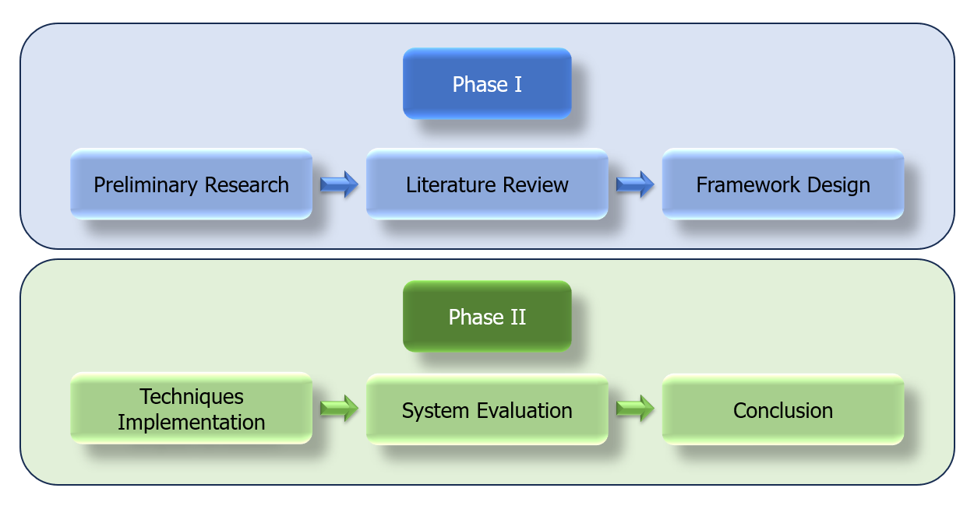
Project framework

Slide 24

PROPOSED METHOD
New Revised Underwater Imaging Model
CNN
Double Model
White Balance
End-to-end Framework

Slide 25
System architecture
Training Phase
Total 3075 images with corresponding ground truth
Image Formation Model
Input
Dataset Preparation
Initialize Training Procedure
Output
White Balance Model
Train Dataset:
Underwater Image Enhancement Benchmark (UIEB) – 890 Images
Enhancing Underwater Visual Perception (EUBP) – 2185 Images

Slide 26
System architecture
Training Parameters
Image Formation Model | Parameters | White Balance Model
3000 | Epochs | 3000
1 | Batch Size | 16
0.001 | Learning Rate | 0.0001
1 | Number of worker | 4
Adam | Optimizer | Adam
Mean Square Error | Loss Function | Mean Absolute Error

Slide 27
System architecture
Input
Output
Testing Phase
Tensor Conversion
Colour Mapping
Image Formation Model
Backward Scatter Estimation Module
Direct Transmission Estimation Module
Reformation Calculation
Auto White Balance Model
Encoder
Decoder
Image Conversion

Slide 28
Input
Tensor Conversion
Image Formation Model
Auto White Balance Model
Image Conversion
Colour Mapping
Output
Input
UIEB
Test Image:
UIEB pair set and challenging set
Collect real-world underwater images
890 paired images
60 challenging images

Slide 29
Input
Tensor Conversion
Image Formation Model
Auto White Balance Model
Image Conversion
Colour Mapping
Output
Tensor conversion

Slide 30

Input
Tensor Conversion
Image Formation Model
Auto White Balance Model
Image Conversion
Colour Mapping
Output
Tensor conversion
Image
(161,
142,
125)
(148,
131,
113)
(128,
111,
093)
(141,
122,
105)
(158,
141,
121)
(138,
121,
101)
(112,
094,
074)
(135,
117,
097)
(138,
120,
100)

Slide 31



Input
Tensor Conversion
Image Formation Model
Auto White Balance Model
Image Conversion
Colour Mapping
Output
Tensor conversion
Image
(161,
142,
125)
(148,
131,
113)
(128,
111,
093)
(141,
122,
105)
(158,
141,
121)
(138,
121,
101)
(112,
094,
074)
(135,
117,
097)
(138,
120,
100)

Slide 32
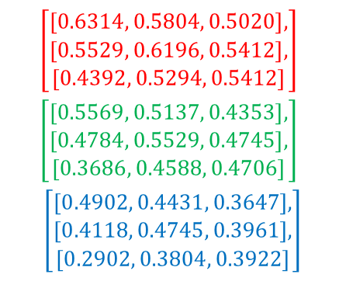
Input
Tensor Conversion
Image Formation Model
Auto White Balance Model
Image Conversion
Colour Mapping
Output
Tensor conversion
161 148 128
141 158 138
112 135 138
Rank 3 Tensor
Image
$$\left[\begin{aligned}\left[\begin{aligned}\left[0.6314, 0.5804, 0.5020\right], \\ \left[0.5529, 0.6196, 0.5412\right], \\ \left[0.4392, 0.5294, 0.5412\right]\end{aligned}\right], \\ \left[\begin{aligned}\left[0.5569, 0.5137, 0.4353\right], \\ \left[0.4784, 0.5529, 0.4745\right], \\ \left[0.3686, 0.4588, 0.4706\right]\end{aligned}\right], \\ \left[\begin{aligned}\left[0.4902, 0.4431, 0.3647\right], \\ \left[0.4118, 0.4745, 0.3961\right], \\ \left[0.2902, 0.3804, 0.3922\right]\end{aligned}\right]\end{aligned}\right]$$
(161,
142,
125)
(148,
131,
113)
(128,
111,
093)
142 131 111
122 141 121
094 117 120
Normalize
(141,
122,
105)
(158,
141,
121)
(138,
121,
101)
Range 0 to 1
(112,
094,
074)
(135,
117,
097)
(138,
120,
100)
125 113 093
105 121 101
074 097 110
NCHW = (1,3,3,3)

Slide 33
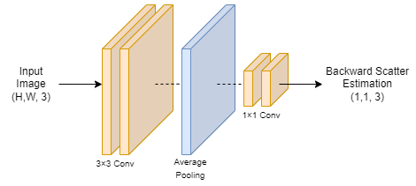
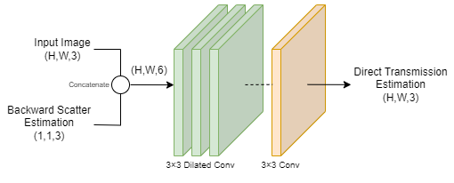
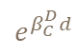

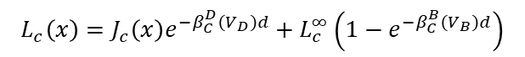
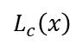
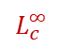
Input
Tensor Conversion
Image Formation Model
Auto White Balance Model
Image Conversion
Colour Mapping
Output
Image formation model
$$L_{c}\left(x\right)=J_{c}\left(x\right)e^{−β_{C}^{D}\left(V_{D}\right)d}+ L_{c}^{∞}\left(1−e^{−β_{C}^{B}\left(V_{B}\right)d}\right)$$
Backward Scatter Estimation Module
Direct Transmission Estimation Module
$$L_{c}\left(x\right)$$
$$L_{c}^{∞}$$
$$e^{β_{C}^{D}d}$$
Reformation Calculation
$$J_{c}\left(x\right)=(L_{c}\left(x\right)−L_{c}^{∞})e^{β_{C}^{D}d}+L_{c}^{∞}$$

Slide 34
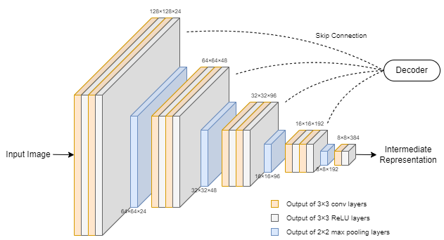
Input
Tensor Conversion
Image Formation Model
Auto White Balance Model
Image Conversion
Colour Mapping
Output
Auto white balance model
Encoder
Down sampled image
before input

Slide 35
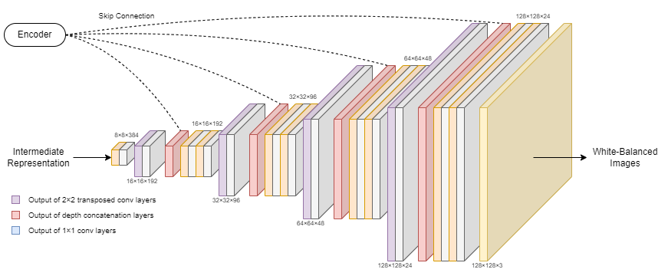
Input
Tensor Conversion
Image Formation Model
Auto White Balance Model
Image Conversion
Colour Mapping
Output
Auto white balance model
Decoder

Slide 36
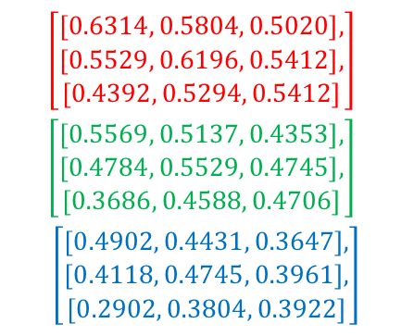
Input
Tensor Conversion
Image Formation Model
Auto White Balance Model
Image Conversion
Colour Mapping
Output
Image conversion
Reverse process of tensor conversion
Rank 3 Tensor
$$\left[\begin{aligned}\left[\begin{aligned}\left[0.6314, 0.5804, 0.5020\right], \\ \left[0.5529, 0.6196, 0.5412\right], \\ \left[0.4392, 0.5294, 0.5412\right]\end{aligned}\right], \\ \left[\begin{aligned}\left[0.5569, 0.5137, 0.4353\right], \\ \left[0.4784, 0.5529, 0.4745\right], \\ \left[0.3686, 0.4588, 0.4706\right]\end{aligned}\right], \\ \left[\begin{aligned}\left[0.4902, 0.4431, 0.3647\right], \\ \left[0.4118, 0.4745, 0.3961\right], \\ \left[0.2902, 0.3804, 0.3922\right]\end{aligned}\right]\end{aligned}\right]$$
Image

Slide 37
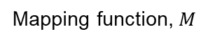
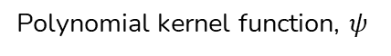

Input
Tensor Conversion
Image Formation Model
Auto White Balance Model
Image Conversion
Colour Mapping
Output
Colour mapping
Auto White Balance Model
Down Sampled
Polynomial Fitting
Mapping function, $M$
$$I^{e}=Mψ\left(I^{i}\right)$$
Polynomial kernel function, $ψ$

Slide 38
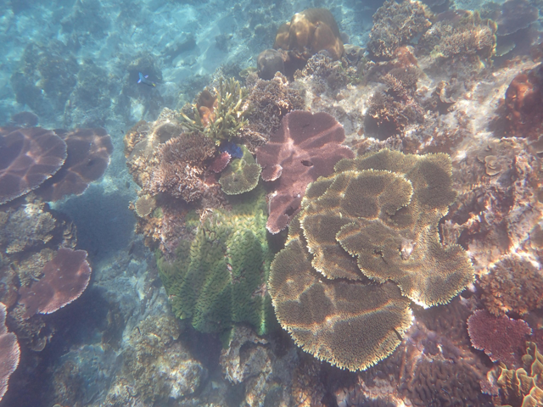
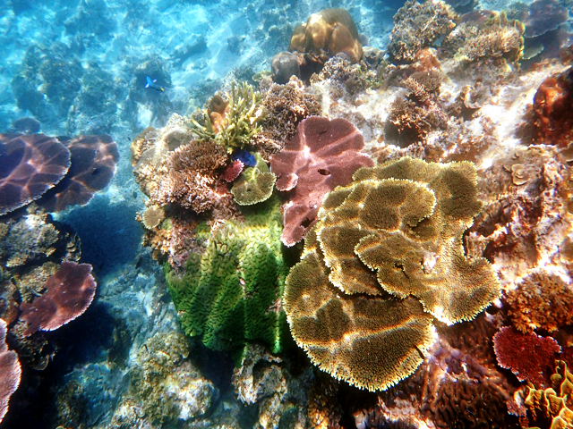
Input
Tensor Conversion
Image Formation Model
Auto White Balance Model
Image Conversion
Colour Mapping
Output
output
Final Output of Proposed System
Colour images
Removed haze
Restored actual colour
Details preserved

Slide 39
Experimental setup
Materials | Unit | Properties | Function
Laptop | 1 | Model: HP Pavilion Laptop 15ec0xxx Processor: AMD Ryzen 7 4800H with Radeon Graphics 2.90 GHz RAM: 16.00GB System type: 64-bit operating system, x64-based processor | To store image conduct the experiment with python and integrated softwarejj
Visual Studio Code | 1 | Version: 1.80.0 System type: 64-bit Integrated Development Environment (IDE) for python | Ve Inte jj
Online Dataset | 2 | UIEB dataset consists of 890 training pair images and 60 challenge images EUVP dataset consists of 2185 training pair images and 130 validation images | Ve Inte jj

Slide 40
Benchmarking - Evaluation
Parameters | Description | Benchmark
Peak Signal-to-Noise Ratio (PSNR) | Higher value, better quality | Noise Quality of general image
Structural Similarity Index Measure (SSIM) | Higher value, more details preserved | Similarity Preserving details in image
Patch-Based Contrast Quality Index (PCQI) | Higher value, better quality | Quality of contrast
Underwater Image Quality Measure (UIQM) | Higher value, better quality | Sharpness, contrast, colourfulness Quality of underwater image
Underwater Colour Image Quality Evaluation | Higher value, better quality | Contrast, luminance, saturation Quality of underwater image

Slide 41
04
Design and implementation
USE CASE • STATE MACHINE • ACTIVITY • CLASS • TRAINING • GUI

Slide 42
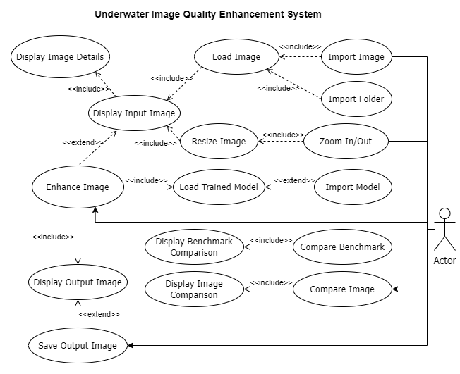
Use case diagram

Slide 43
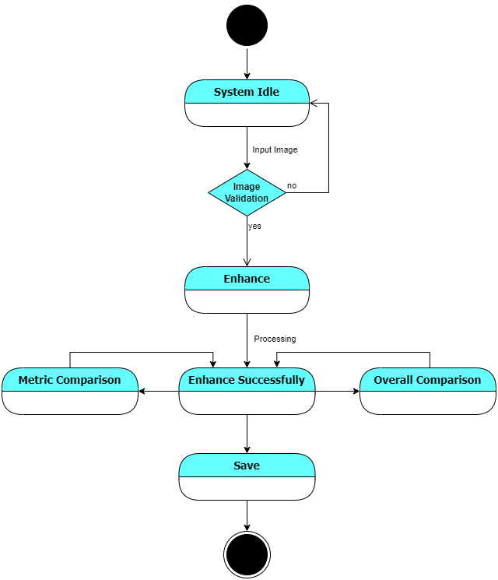
State machine diagram

Slide 44
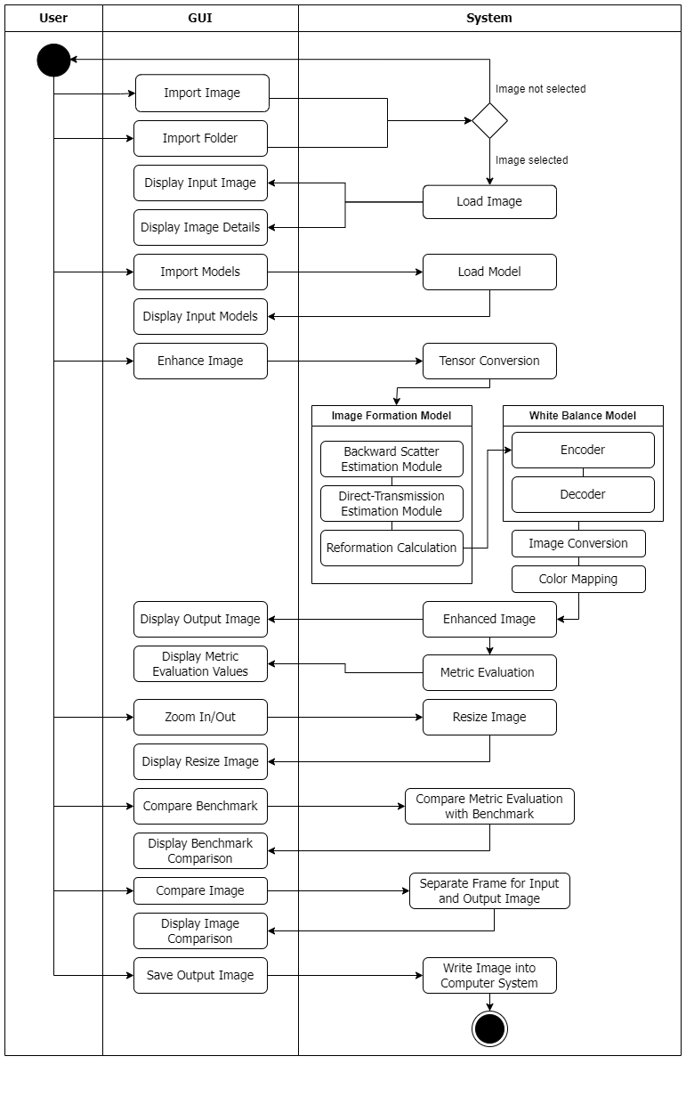
Activity diagram

Slide 45
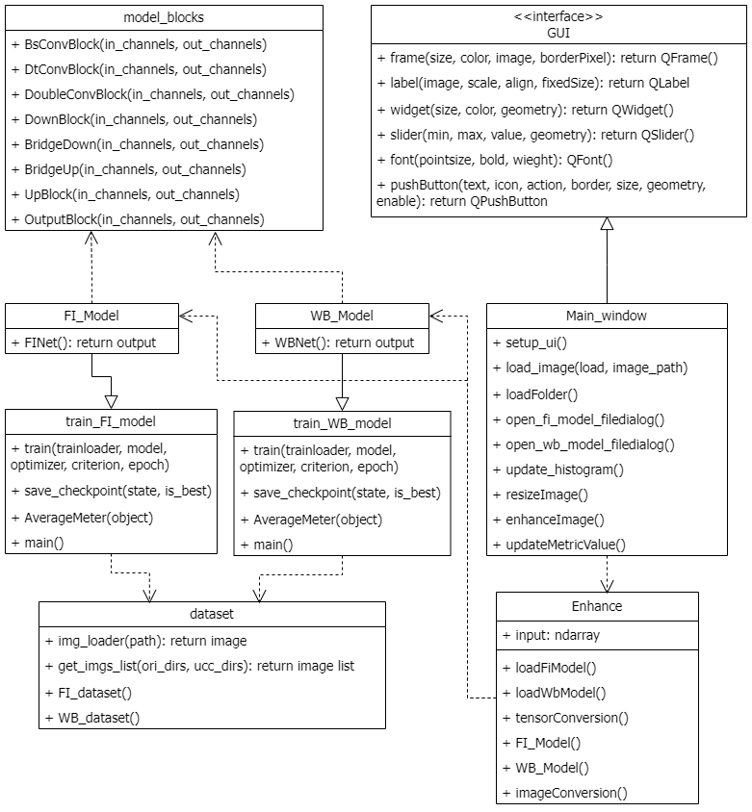
Class diagram

Slide 46
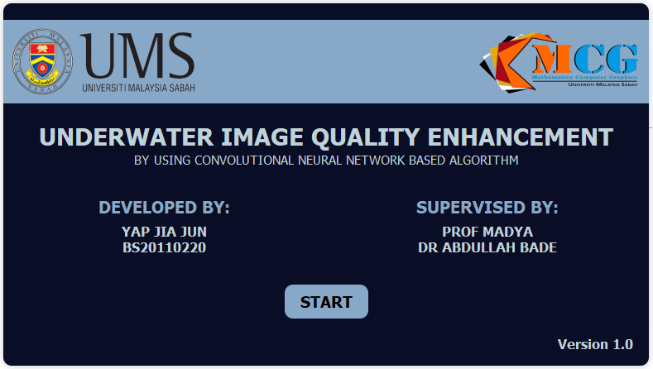
Graphical USER INTERFACE

Slide 47
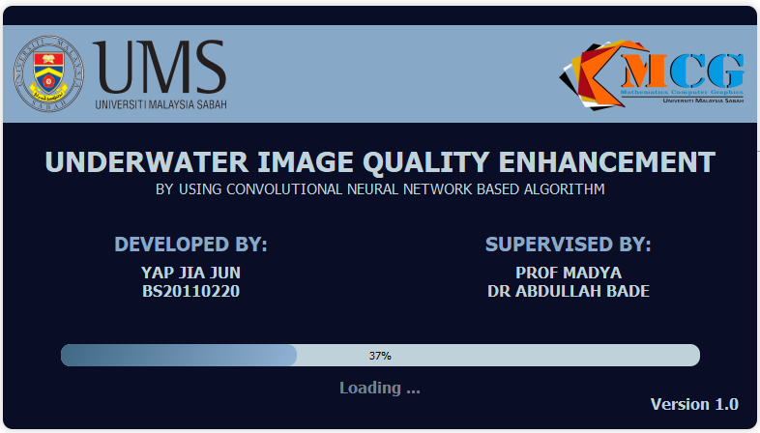
Graphical USER INTERFACE

Slide 48
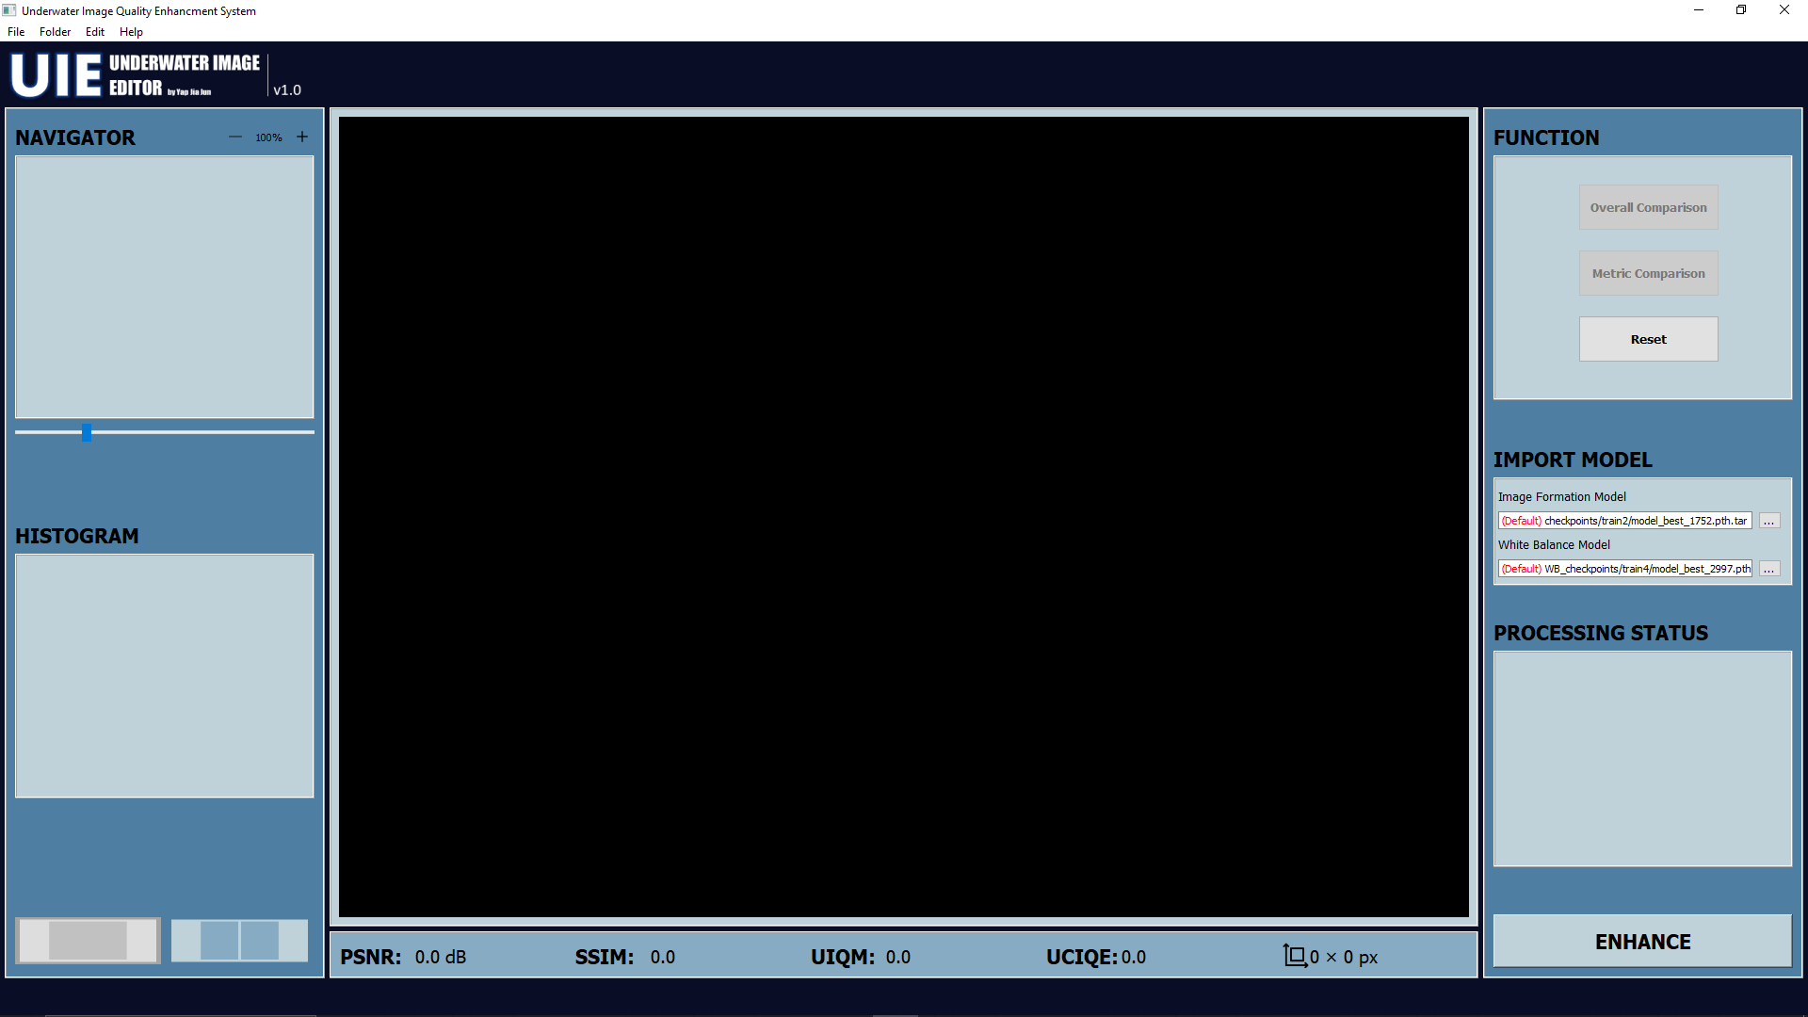
Graphical USER INTERFACE

Slide 49
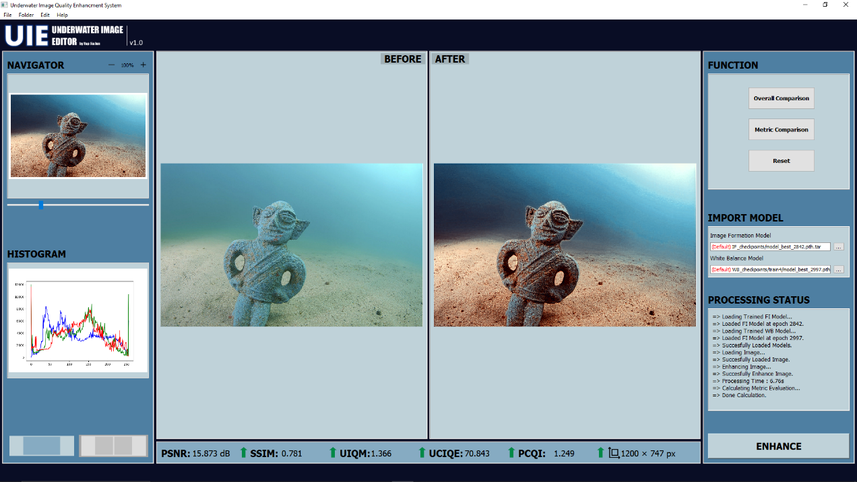
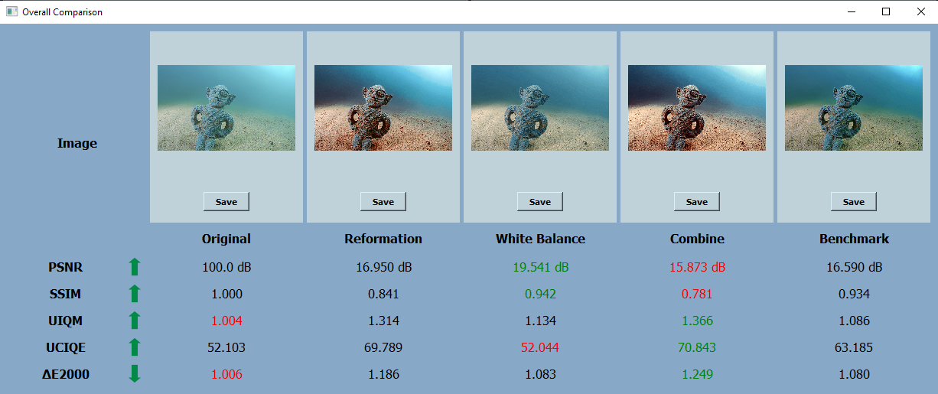
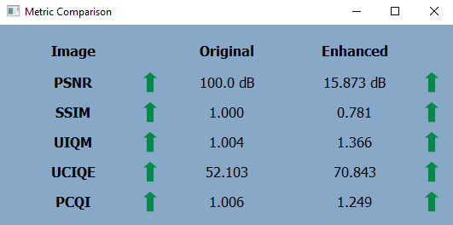
Graphical USER INTERFACE

Slide 50
05
RESULT AND DISCUSSION
VISUAL QUALITY • EVALUATION METRICS

Slide 51
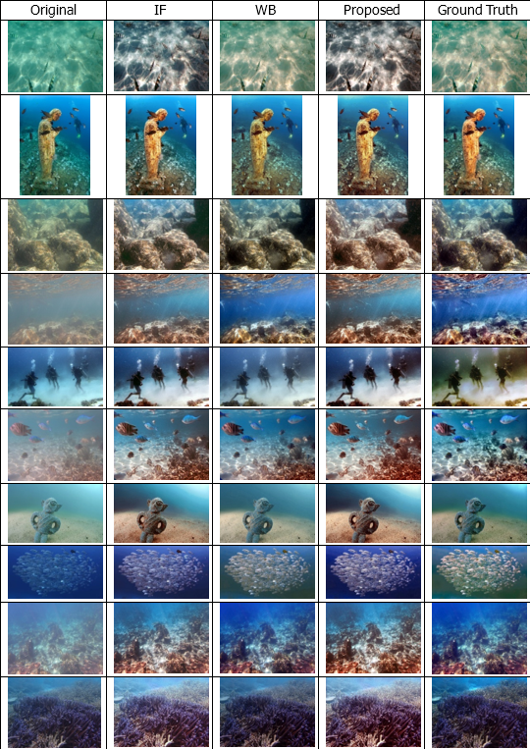
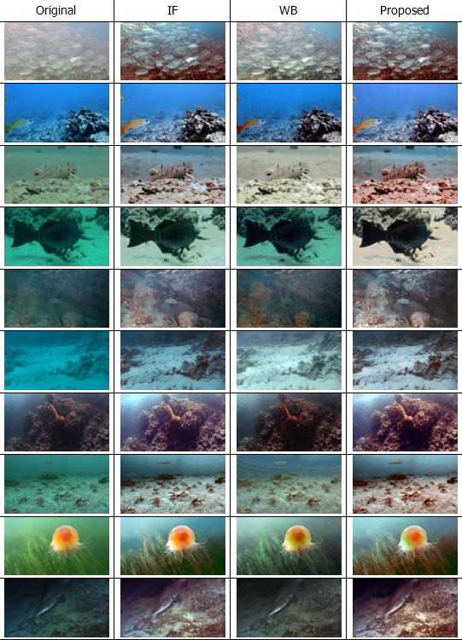
Test images
Total
20 Images
With ground truth
Without ground truth

Slide 52
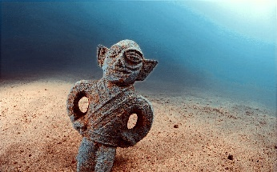
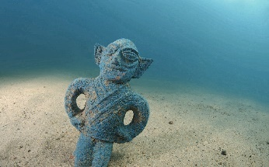
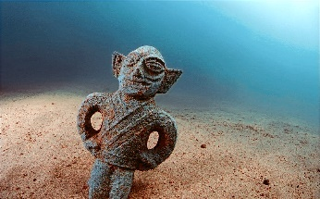
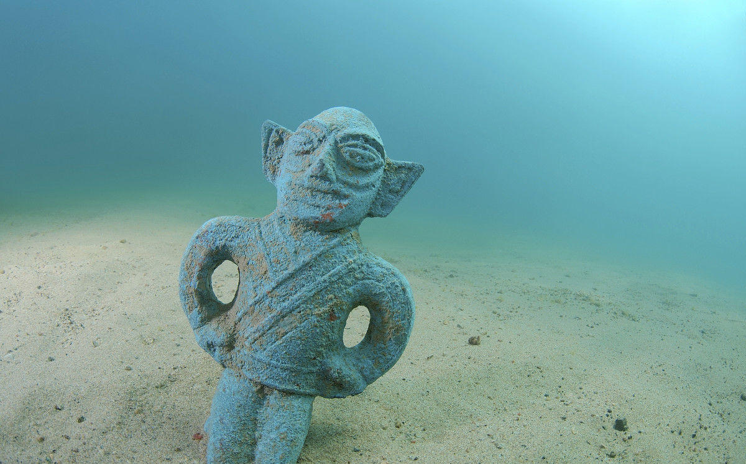
Visual Quality

Slide 53
Visual Quality
Image Formation Model
Original
Proposed
White Balance Model

Slide 54
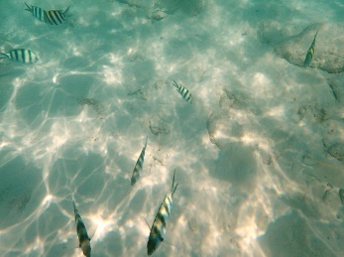
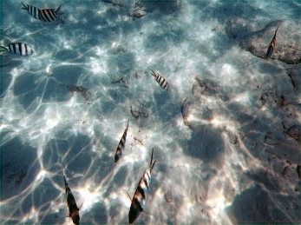
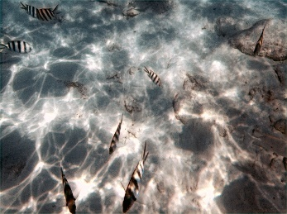
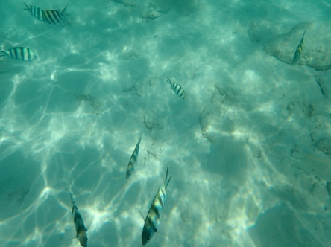
Visual Quality

Slide 55
Visual Quality
Image Formation Model
Original
Proposed
White Balance Model

Slide 56
Metric Evaluation
Metrics | SSIM | PSNR | PCQI | UIQM | UCIQE
Image Formation Model | 0.837 | 17.058 | 1.182 | 0.964 | 62.051
White Balance Model | 0.888 | 19.726 | 1.029 | 0.812 | 55.162
Combined (Proposed) | 0.772 | 15.513 | 1.274 | 1.069 | 66.138

Slide 57
Metric Evaluation
Metrics | SSIM | PSNR | PCQI | UIQM | UCIQE
Image Formation Model | 0.837 | 17.058 | 1.182 | 0.964 | 62.051
White Balance Model | 0.888 | 19.726 | 1.029 | 0.812 | 55.162
Combined (Proposed) | 0.772 | 15.513 | 1.274 | 1.069 | 66.138

Slide 58
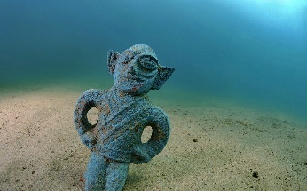
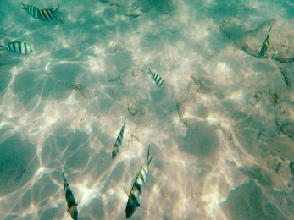
Compare with Ground truth

Slide 59
Compare with Ground truth

Slide 60
Compare with Ground truth
Original
Proposed
Ground Truth

Slide 61
Compare with Ground truth
Metrics | PCQI | UIQM | UCIQE
Combined (Proposed) | 1.515 | 1.226 | 68.070
Ground Truth | 1.352 | 1.008 | 62.531

Slide 62
Compare with Ground truth
Metrics | PCQI | UIQM | UCIQE
Combined (Proposed) | 1.515 | 1.226 | 68.070
Ground Truth | 1.352 | 1.008 | 62.531

Slide 63
06
CONCLUSION
SUMMARY • CONTRIBUTION • FUTURE WORK

Slide 64
SUMMARY
The concept of underwater image enhancement and deep learning were introduced
Understand the problem effecting the degradation of underwater image.
The issues been overcome by using deep learning algorithm with image formation model and white balance model
A deep learning-based underwater image enhancement system was implemented
Objectives achieved

Slide 65
CONTRIBUTIONS
Training White Balance Model
Combination of Both Models
3075 Underwater images
Perform in Colour Balance
Sequential integration
End to end framework

Slide 66
FUTURE WORK
Integration of Both Models into Unified Framework
Integration for Efficiency
Adaptability Improvement
Simplified Parameter Tuning
Expanded Dataset Training
Limited Underwater Dataset
Encompassing Various Environments
Comprehensive Model Learning

Slide 67
References
Afifi, M., & Brown, M. S. (2020). Deep White-Balance Editing.
Akkaynak, D., & Treibitz, T. (2018). A Revised Underwater Image Formation Model. Proceedings of the IEEE Computer Society Conference on Computer Vision and Pattern Recognition, 6723– 6732. https://doi.org/10.1109/CVPR.2018.00703
Cai, B., Xu, X., Jia, K., Qing, C., & Tao, D. (2016). DehazeNet: An End-to-End System for Single Image Haze Removal. https://doi.org/10.1109/TIP.2016.2598681
Chen, X. (2019). Image enhancement effect on the performance of convolutional neural networks. www.bth.se
Chen, X., Zhang, P., Quan, L., Yi, C., & Lu, C. (2021). Underwater Image Enhancement based on Deep Learning and Image Formation Model. https://github.com/xueleichen/PyTorch-Underwater-
Downing, J. (2008). Effects of Light Absorption and Scattering in Water Samples on OBS ® Measurements.
Fu, X., & Cao, X. (2020). Underwater image enhancement with global–local networks and compressed- histogram equalization. Signal Processing: Image Communication, 86. https://doi.org/10.1016/j.image.2020.115892

Slide 68
References
Hu, Y., Wang, K., Zhao, X., Wang, H., & Li, Y. (2018). Underwater Image Restoration Based on Convolutional Neural Network. In Proceedings of Machine Learning Research (Vol. 95).
Katherine, A. S., Junming, Z., Elizabeth, A. O., & Matthew, J.-R. (2019). 2019 International Conference on Robotics and Automation (ICRA).
Li, C., Guo, C., Ren, W., Cong, R., Hou, J., Kwong, S., & Tao, D. (2019). An Underwater Image Enhancement Benchmark Dataset and Beyond. http://arxiv.org/abs/1901.05495
Li, C., Guo, J., & Guo, C. (2017). Emerging from Water: Underwater Image Color Correction Based on Weakly Supervised Color Transfer. https://doi.org/10.1109/LSP.2018.2792050
Li, H., Li, J., & Wang, W. (2019). A Fusion Adversarial Underwater Image Enhancement Network with a Public Test Dataset. http://arxiv.org/abs/1906.06819
Liu, P., Wang, G., Qi, H., Zhang, C., Zheng, H., & Yu, Z. (2019). Underwater Image Enhancement with a Deep Residual Framework. IEEE Access, 7, 94614–94629. https://doi.org/10.1109/ACCESS.2019.2928976
Lu, H., Li, Y., Uemura, T., Kim, H., & Serikawa, S. (2018). Low illumination underwater light field images reconstruction using deep convolutional neural networks. Future Generation Computer Systems, 82, 142–148. https://doi.org/10.1016/j.future.2018.01.001

Slide 69
References
Luo, M. R., Cui, G., & Rigg, B. (2000). The Development of the CIE 2000 Colour-Difference Formula: CIEDE2000.
Narasimhan, S. G., & Nayar, S. K. (2002). Vision and the Atmosphere. In International Journal of Computer Vision (Vol. 48, Issue 3).
Narayan Subudhi, B., Kapoor, M., Kumar Rout, D., Thangaraj, V., Jakhetiya, V., & Veerakumar, T. (2023). Passive Visual Underwater Surveillance: A Survey. https://doi.org/
Pan, P. W., Yuan, F., & Cheng, E. (2018). Underwater image de-scattering and enhancing using dehazenet and hwd. Journal of Marine Science and Technology (Taiwan), 26(4), 531–540. https://doi.org/10.6119/JMST.201808_26(4).0006
Perez, J., Attanasio, A. C., Nechyporenko, N., & Sanz, P. J. (2017). A Deep Learning Approach for Underwater Image Enhancement.
Pooja, S., Neelesh, G., & Neetu, S. (2014). A Survey on Underwater Image Enhancement Techniques.

